Slide 1
Interacting with Web APIs Using Swagger Inspector and Codegen

Slide 2

Use Swagger Inspector to:
Overview
Access web APIs
Test web APIs
Interrogate web APIs
Generate OpenAPI documents
Use Swagger Codegen to:
Generate Client SDKs
Generate Server Stubs

Slide 3

Interrogating a Web API

Slide 4
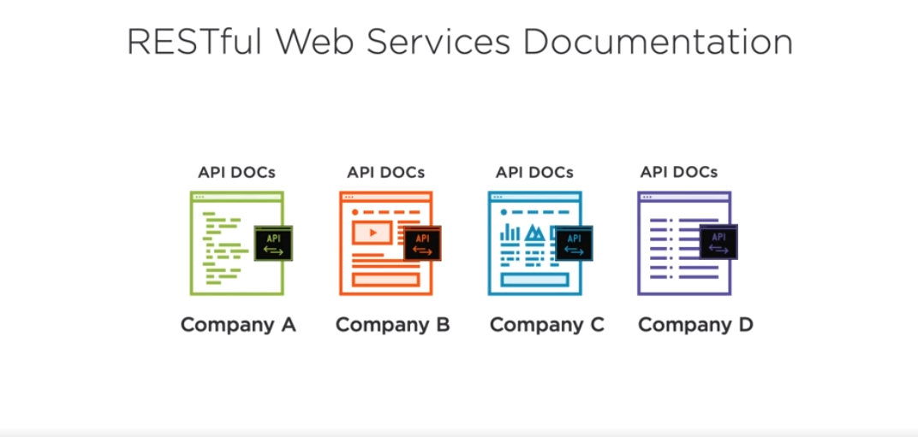

Slide 5
Summary
Load an OpenAPI document into the Swagger Inspector to test its operations
Access a web service without an OpenAPI definition and create one.

Slide 6
Generate Client SDKs and Server Stubs

Slide 7
C++ and C#
Java SE
Java, Kotlin, Scala, Clojure, Groovy
JavaScript Typescript
Angular, AngularJS, Fetch, IntensifyJS,
Python, Perl, PHP, Ruby Objective-C and Swift SalesForce Apex Google Go and Dart Flash
SDK
Languages

Slide 8
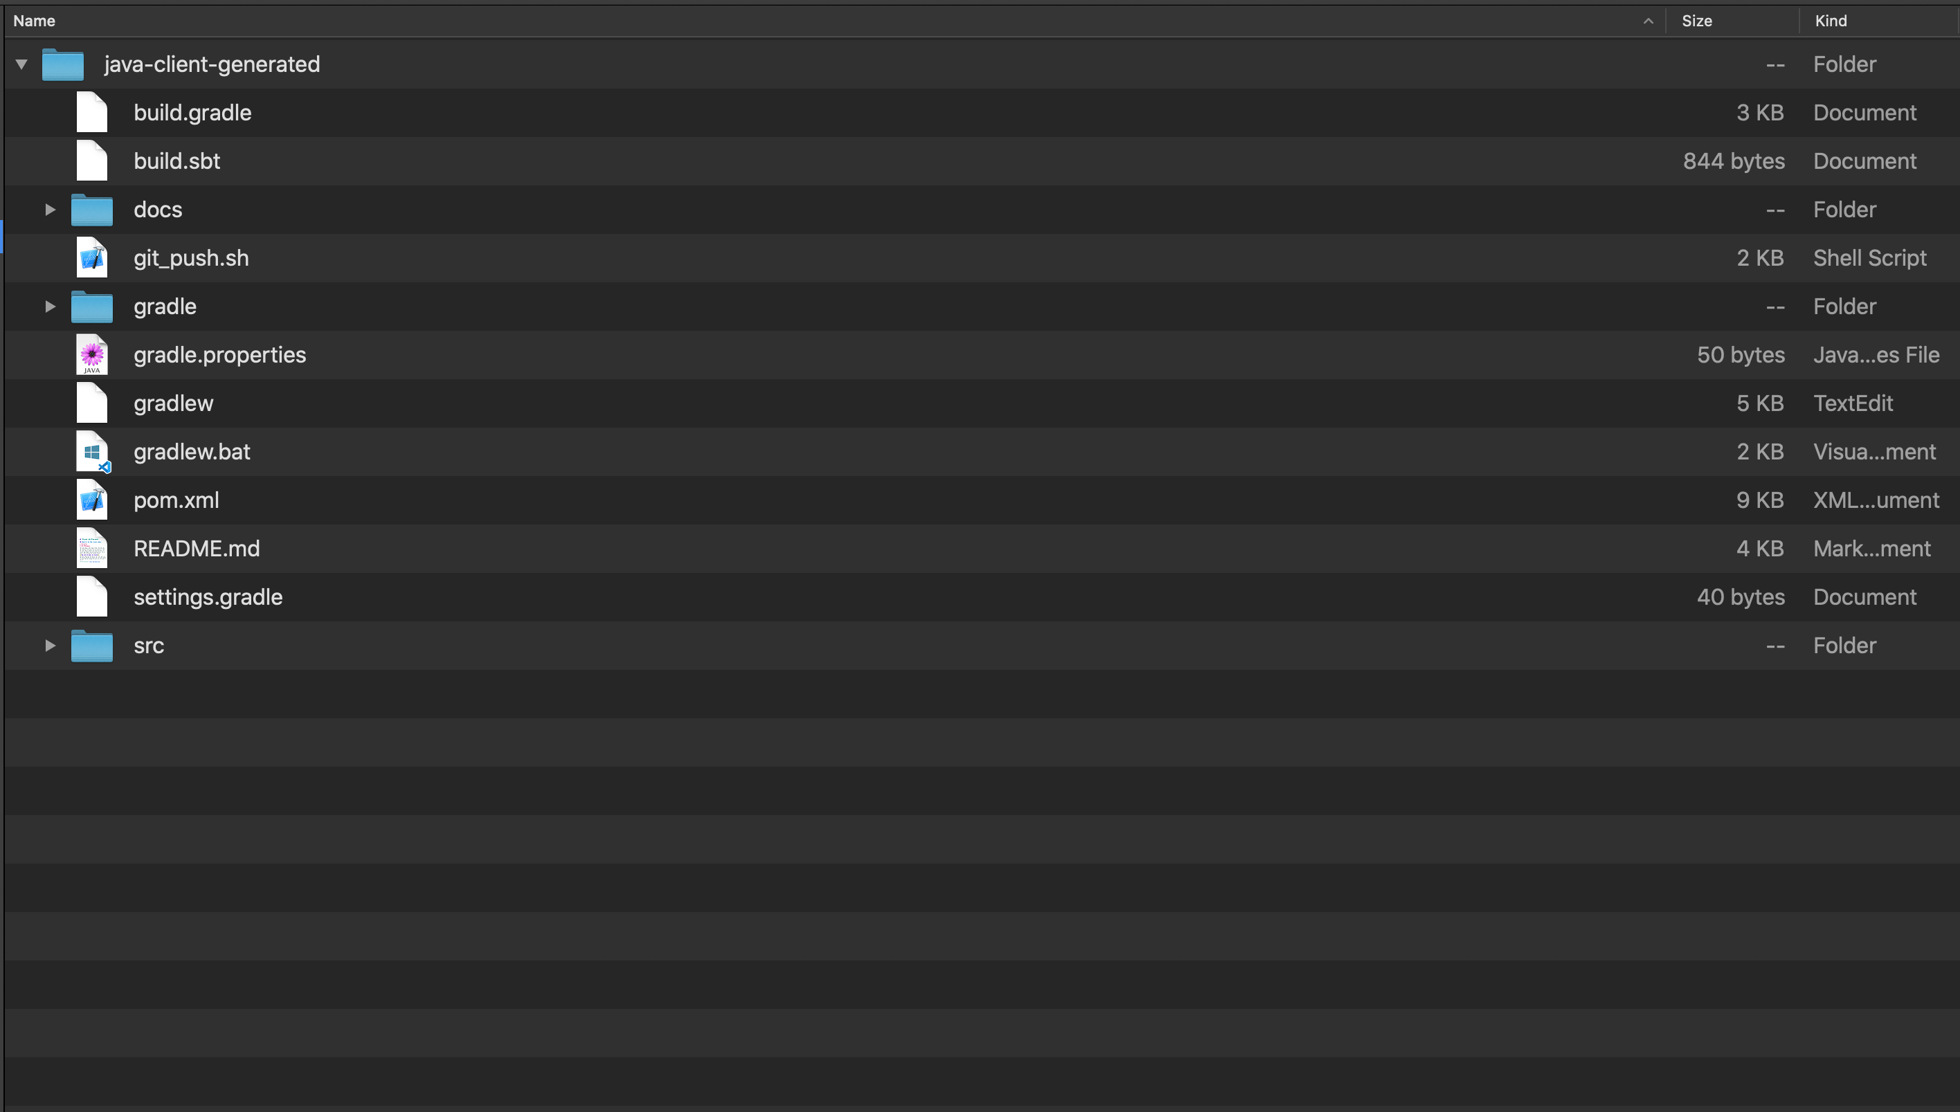
Java SE

Slide 9
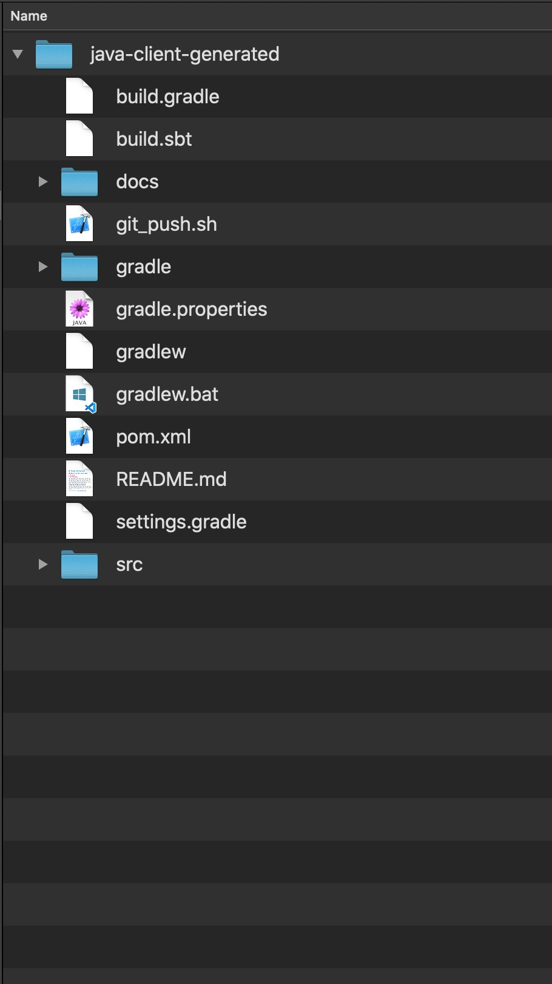
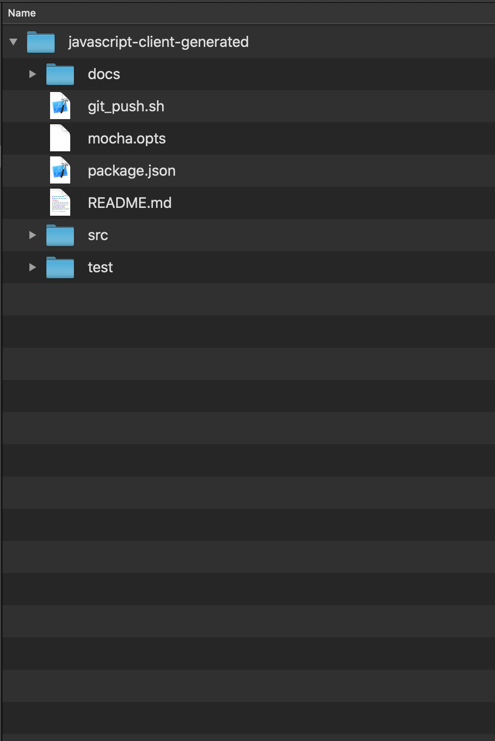
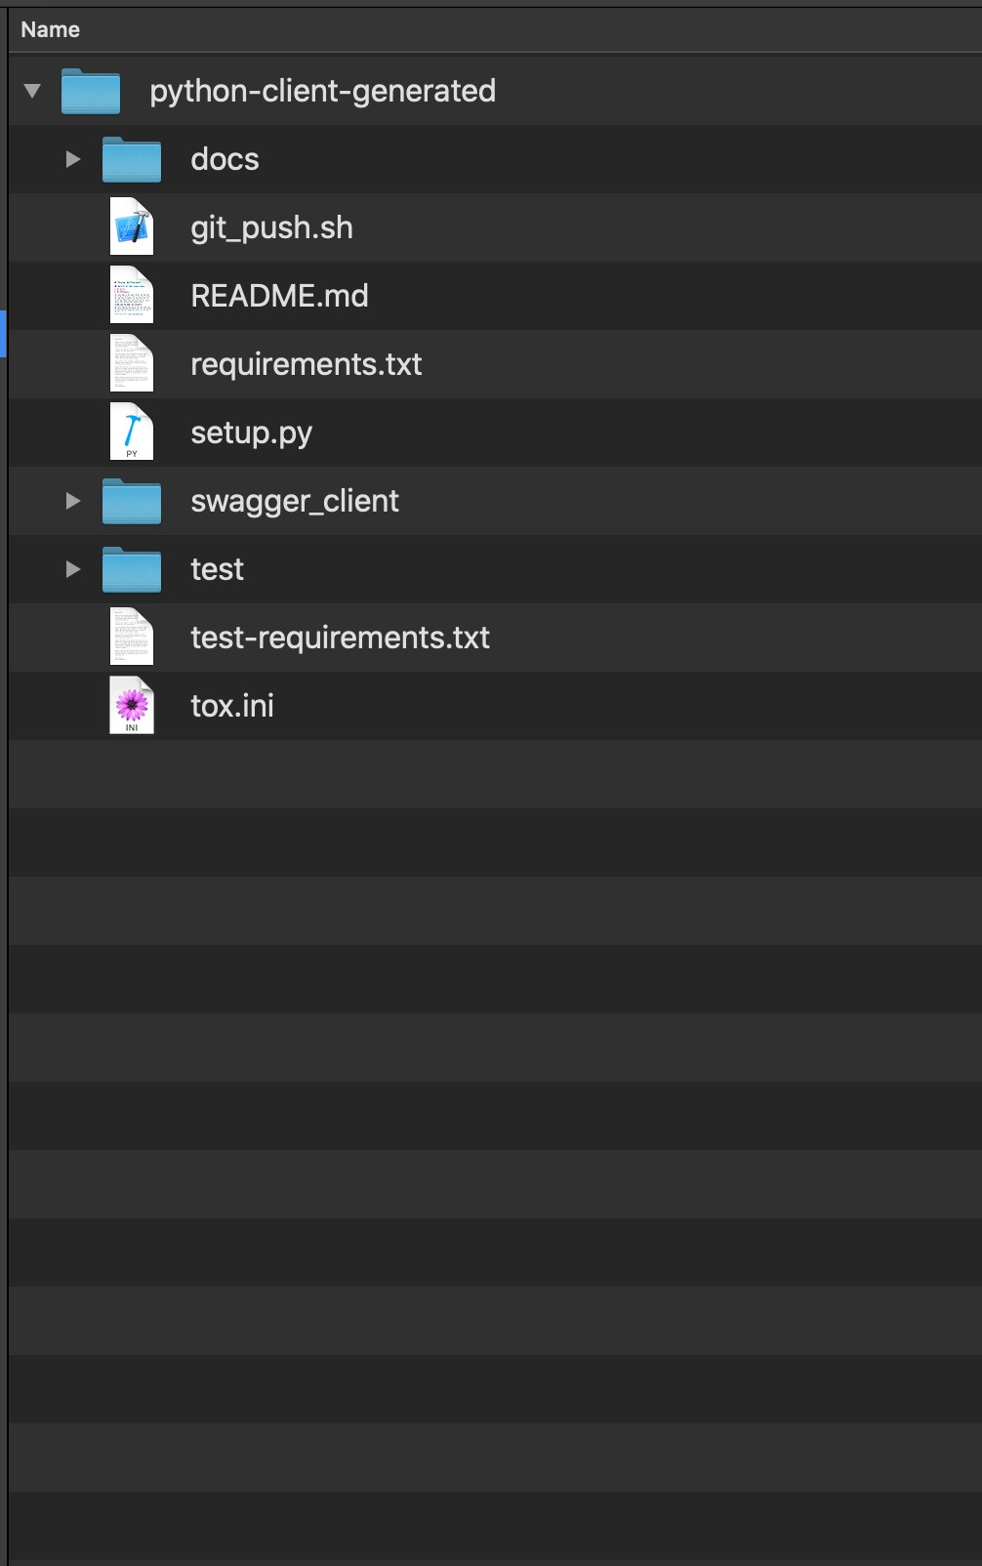
JavaScript
Java SE
Python

Slide 10
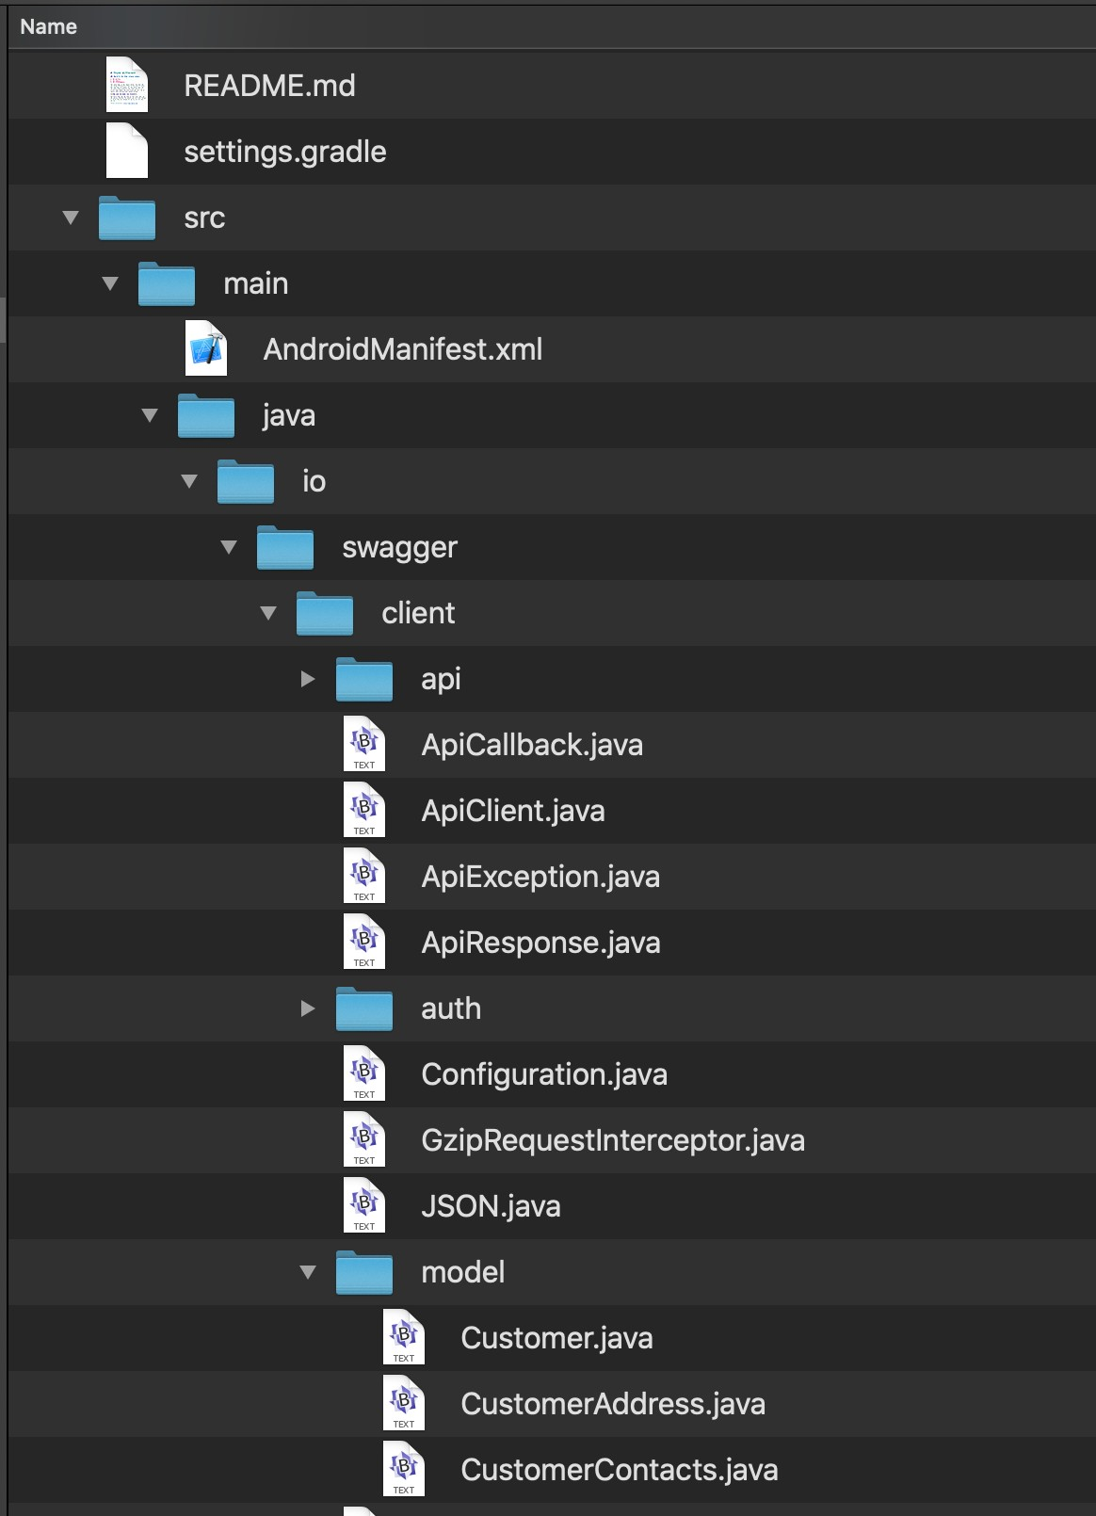
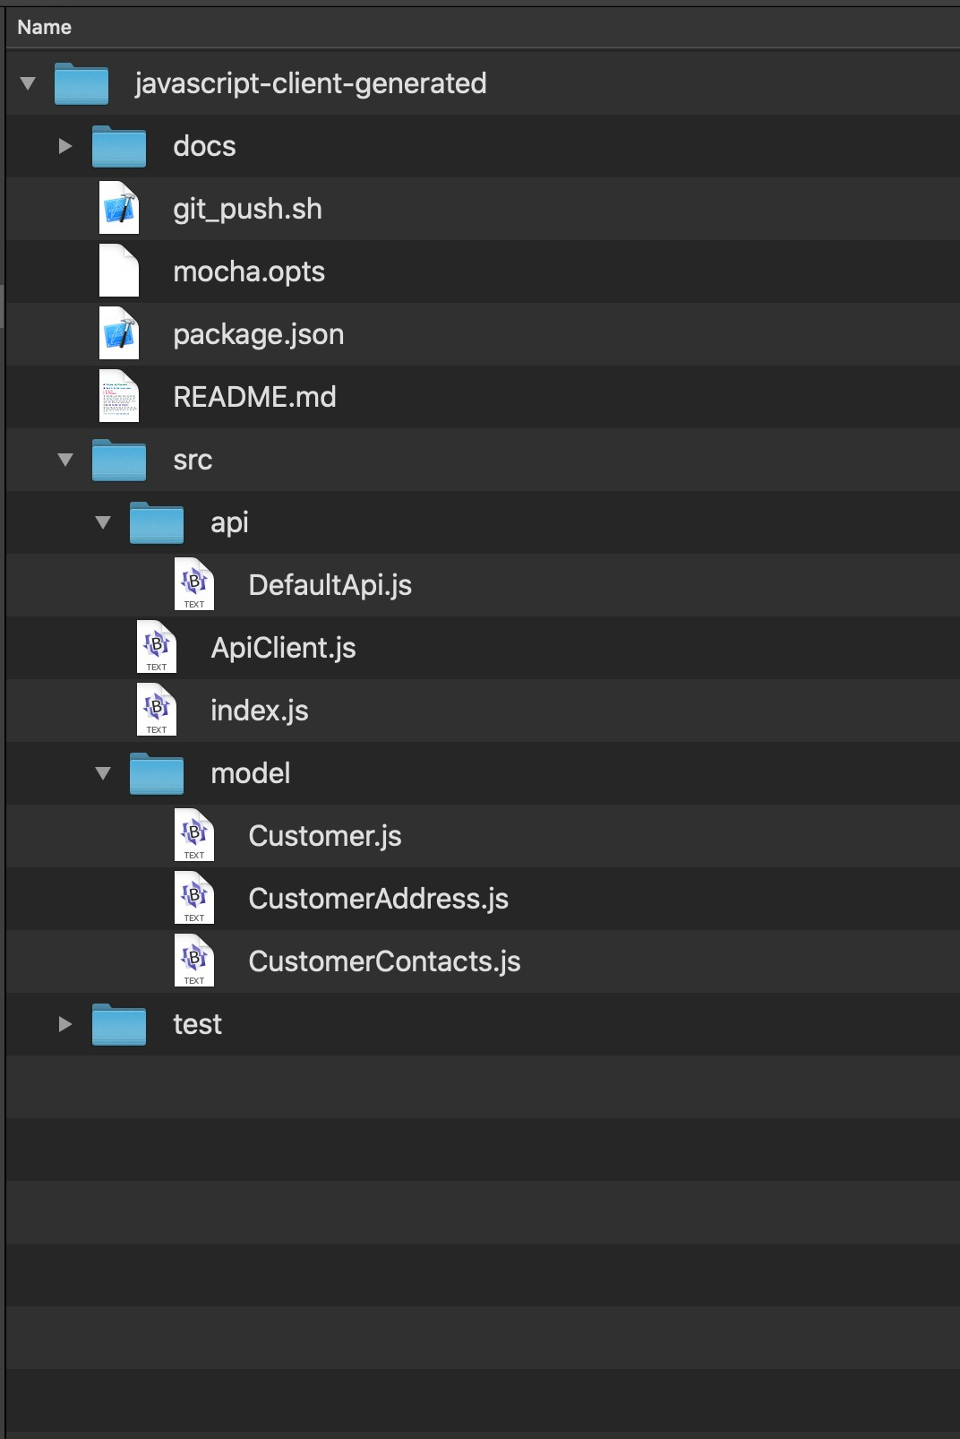
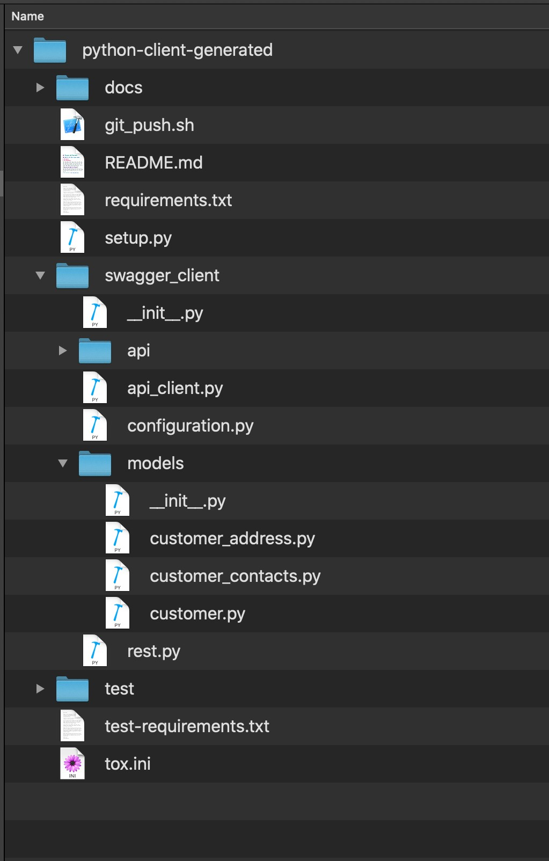
JavaScript
Java SE
Python

Slide 11
Spring and JAX-RS for Java Node.js for JavaScript ASP.NET for C#
Server Stub Frameworks
Go Server for Go Flask for Python Akka for Scala

Slide 12
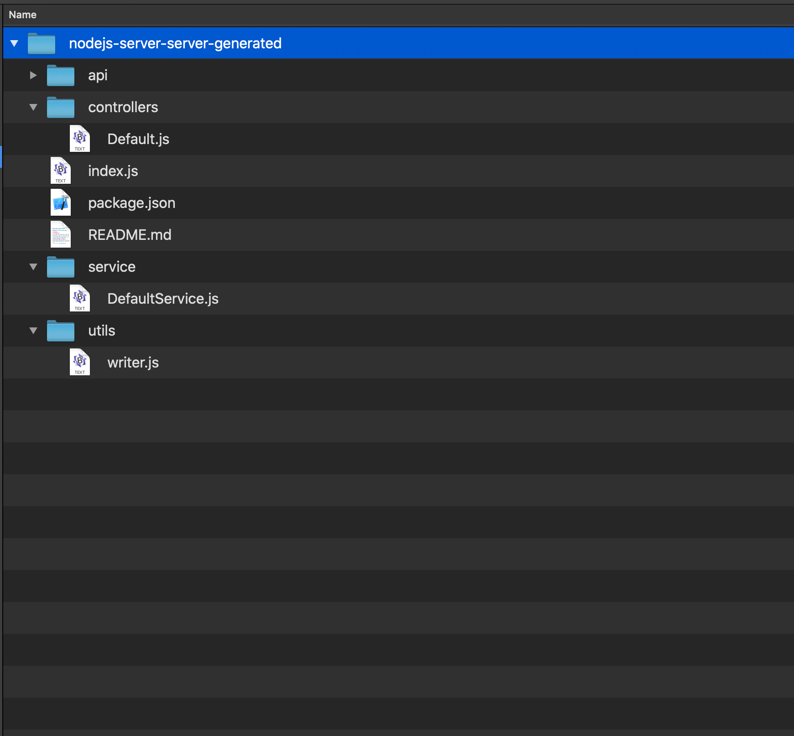
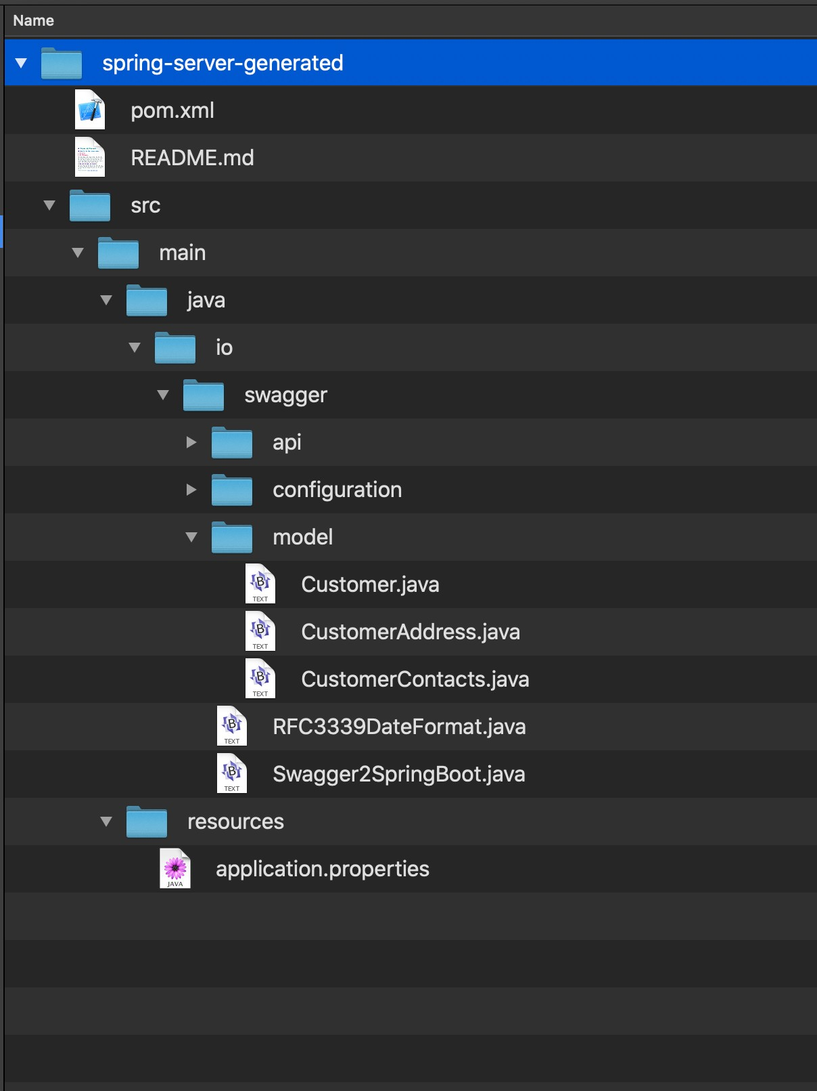
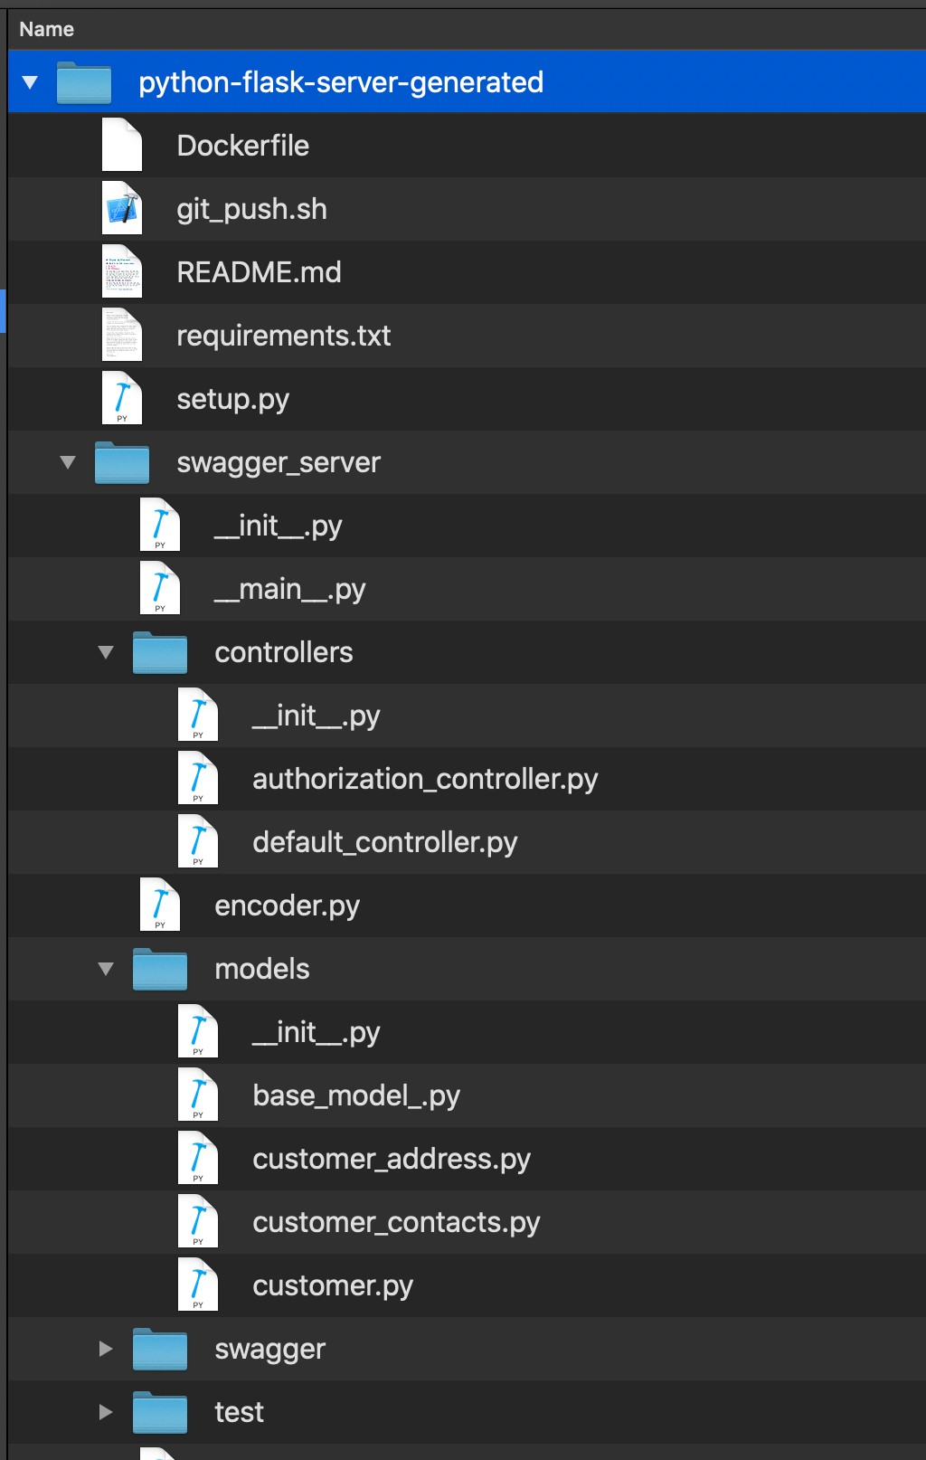
Node.js
Spring
Flask

Slide 13
Swagger Codegen
Advantages
Code generated by Swagger Codegen
is fast
Code can evolve as the OpenAPI doc
evolves
Disadvantages
The generated code is fixed. Not a lot of flexibility.
Regenerating client SDKs and server stubs leaves out business logic

Slide 14










RESTful Web Services
Java
Spring
C#
ASP.NET
Python
Flask
JavaScript
Node.js
Go
Go Server

Slide 15
RESTful Web Services
Java
Spring
C#
ASP.NET
Python
Flask
JavaScript
Node.js
Go
Go Server

Slide 16
RESTful Web Services
Java
Spring
C#
ASP.NET
Python
Flask
JavaScript
Node.js
Go
Go Server

Slide 17
Summary
Load an OpenAPI document into the Swagger Inspector to test its operations
Access a web service without an OpenAPI definition and create one.
Generate Client SDKs and Server Stubs in Java, JavaScript, and Python.

